Slide 1
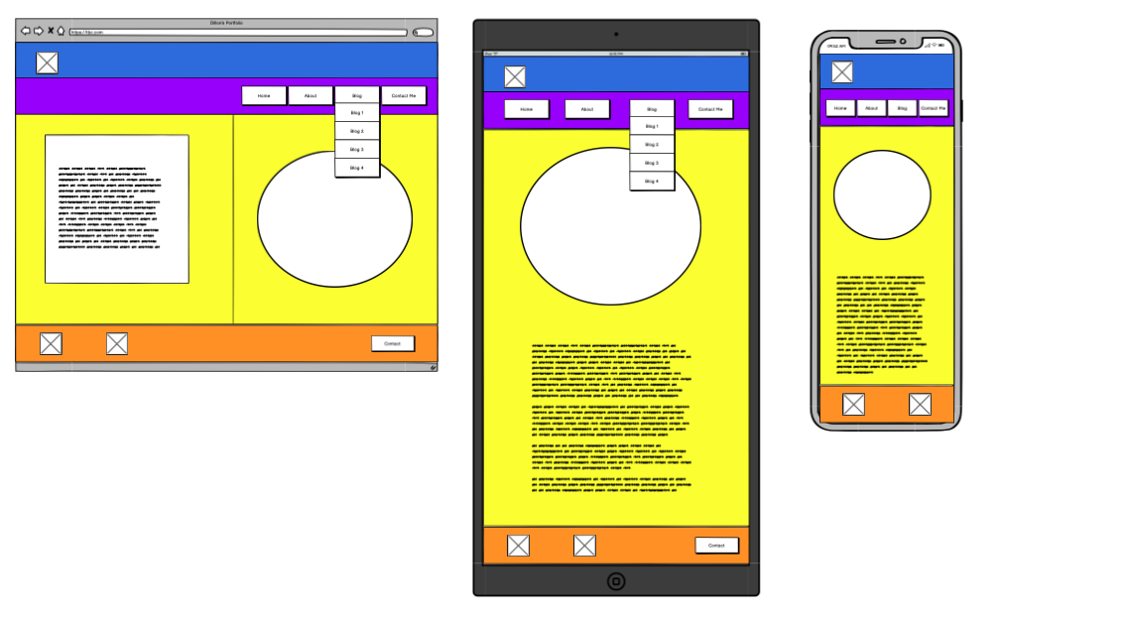
Portfolio Website - Home
Key Features:
Rounded image.
Animation on hover for the ”Welcome!” text
Text box with decent spacing for the heading and content.

Slide 2
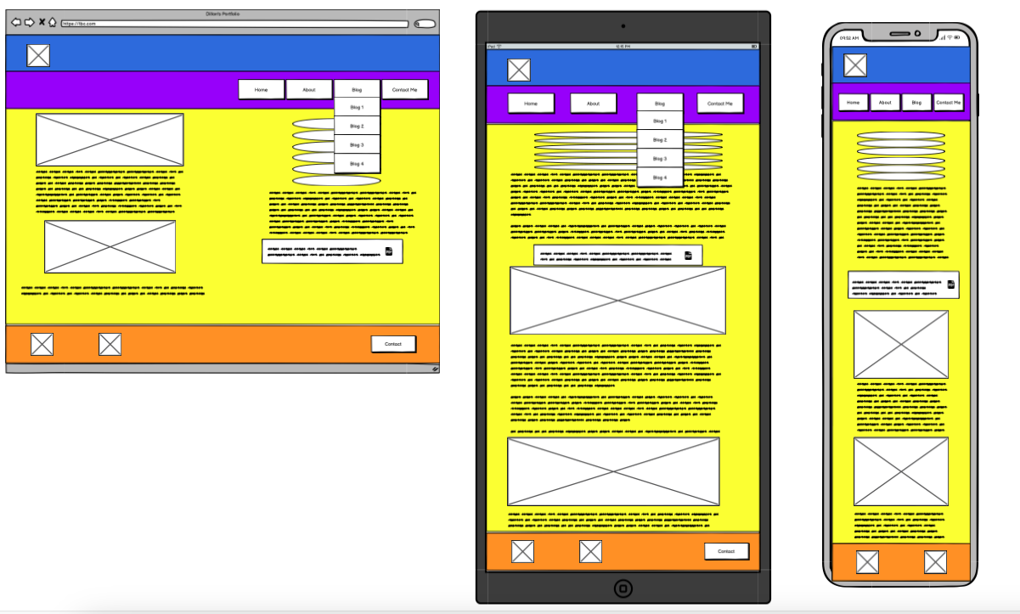
Portfolio Website - About
Key Features:
Work History callouts
Resume link
Rounded corners on images appropriately sized

Slide 3
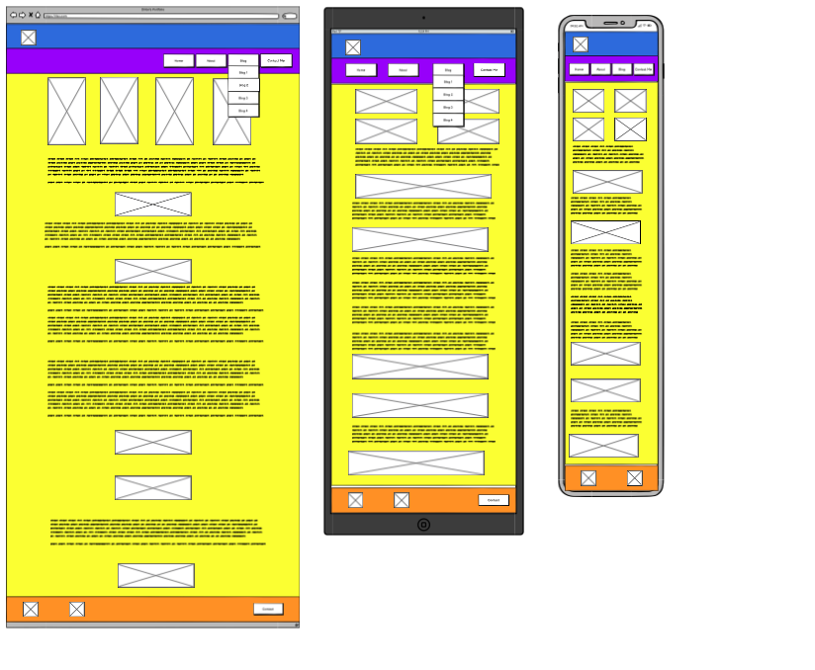
Portfolio Website - Blog
Key Features:
Animation on images to make opaque
Animation on text within pictures to make visible
Links to each separate blog post

Slide 4
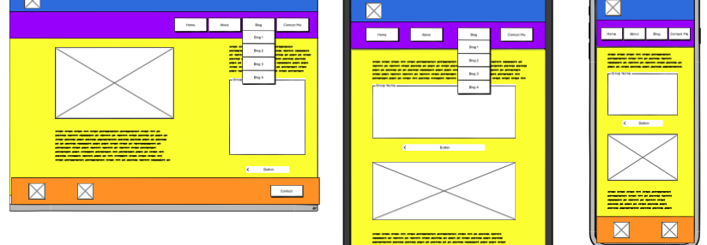
Portfolio Website - Contact
Key Features:
Fillable form
Map of general area
3 callouts on separate contact methods

Slide 5
Portfolio – Header component
Key feature:
Animation of ‘Zoom’ on page load

Slide 6
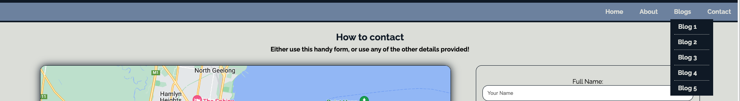
Portfolio – Nav component
Key feature:
Drop down of blogs when hovered (tablet and above view)

Slide 7
Portfolio – Footer component
Key feature:
Links to sites
Contact me mailto: link

Slide 8

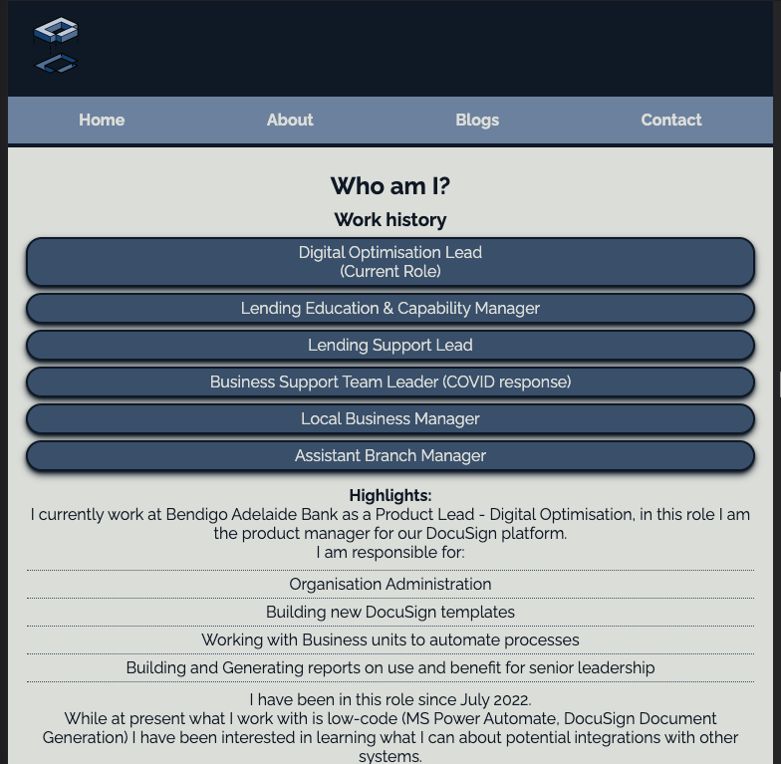
Portfolio – Responsive design
Features:
Built with mobile first in mind.
Altered layout from vertical scrolling in mobile to side-by-side when in a laptop
Nav bar spreads evenly in tablet and mobile
Nav bar Blog drop-down hides in mobile
Footer hides email mailto: in mobile

Slide 9
Process
My initial process was to think about how best to display information on a screen. I knew that picture elements were going to play a large part as a visual medium is more appealing.
I was stuck on working out what content should be included on the index slide for some time before coming to a conclusion.

Slide 10
Initial design
The design elements I knew I wanted to share across the pages were likely to be slightly more complex.
The first was in the navigation bar:
I wanted to have the navigation bar appear on every page the same,
I wanted the navigation items to be evenly spread on mobile and tablet, but when viewed in large enough screen size, this should appear on the right-hand side.
I wanted direct links to the blog posts from the navigation bar.
This last part was key for me, I found a few resources on how I could get this to work (list within a list) and styling suggestions on how to make it appear directly underneath the “Blogs” text.

Slide 11
Initial Design cont.
I also wanted the same Header and Footer, to tie all the pages together, and reduce the amount of code required.
The header had to have a logo, which also appears as the favicon, and I wanted an animation on this.
I tried a few animation types, fading (which was repurposed later) or sliding, but ended up settling on a zoom animation.
The footer was similar (though no animation) however I had to do some adjustments on the sned icon in the Contact Me space. The original colour was black, and I didn’t like the images in white, so looked up how I could alter using styling to change colour.
I got initial advice from Chat GPT, however found that it was not 100% correct, but used this information to narrow down regular searching until I was able to implement the change.

Slide 12
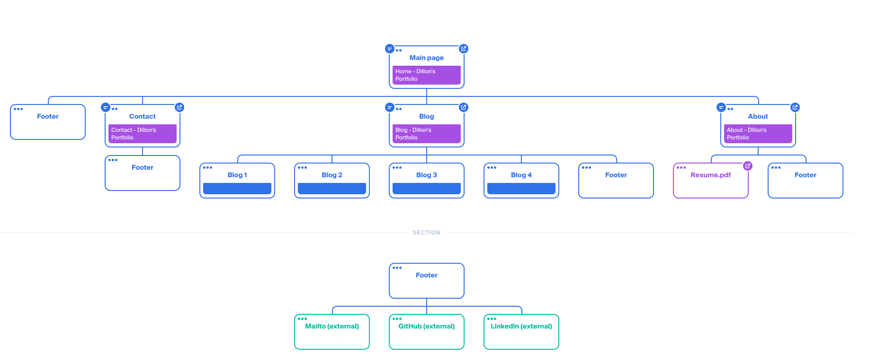
Sitemap

Slide 13
Shapes and images - Home
The image on the home page is actually a div with an image set as a background.
This was done, as when I used an image and added a 50% border-radius it ended up as an oval, and I did not want to mess with the image dimensions too much.
Instead by creating a div, and setting its particular width and height, I could then make it round by the same border radius of 50% and then hide the overflow
The text div I wanted to look more dynamic than a simple text block, so added a slight shadow to the div, and rounded the edges (a common theme throughout).
I liked the look of very rounded edges on Mobile and Tablet, but it looked wrong on Laptop, so lessened them here.

Slide 14
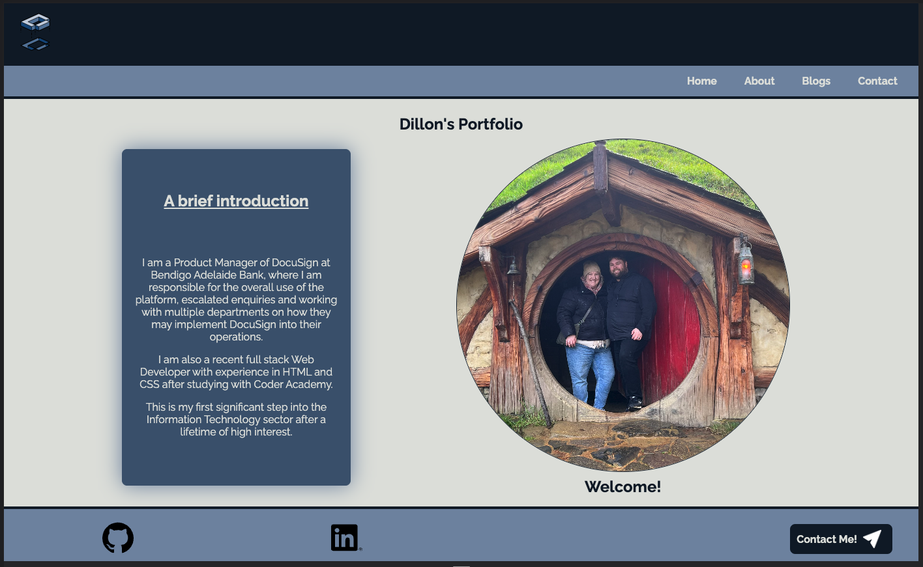

Slide 15
Shapes and images - About
Similar to Home, I wanted rounded edges on the Work History ‘cards’, but this time I wanted a 3D effect. I looked up how I could implement this with multiple shadows being layered, and really liked the effect.
The About section was actually the last part of the build, and I seriously considered going back to each other style to implement this on the other shadow sections, however, I deemed this to be a unique part of the user experience, as this page should be the part to hold interest.
I had to set some image max widths when viewing in Laptop as the larger the view width, the bigger the images, until it looked really out of place.
I added a 512px max limit, which I then added to the blog images later, as thought this was a good design choice.

Slide 16
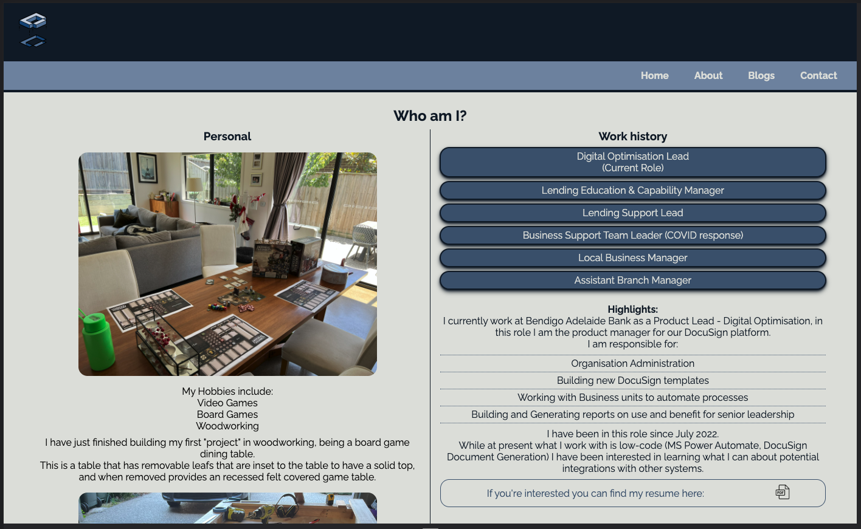

Slide 17

Shapes and Images - Blog
Part of my initial design that I knew I wanted to implement were blog cards of images that linked to the blog posts.
The way to get the animation work may have taken the longest out of any single component. Advice when searching online and asking ChatGPT all gave responses that did not do the task I was specifically looking for using just style sheets.
I then had an idea to use the fade transition I previously thought of for the logo, which had varying success due to the text underneath (I was able to get the background to fade, but it also faded the text)
Finally, I worked out that if I created duplicates of the images, with lower opacity, I could then make the background transition from one image to the other, which gives the appearance of fading.
I may have made this harder than it needed to be, but this was the only solution I could come up with that included keeping the Blog hyperlink text as well.

Slide 18
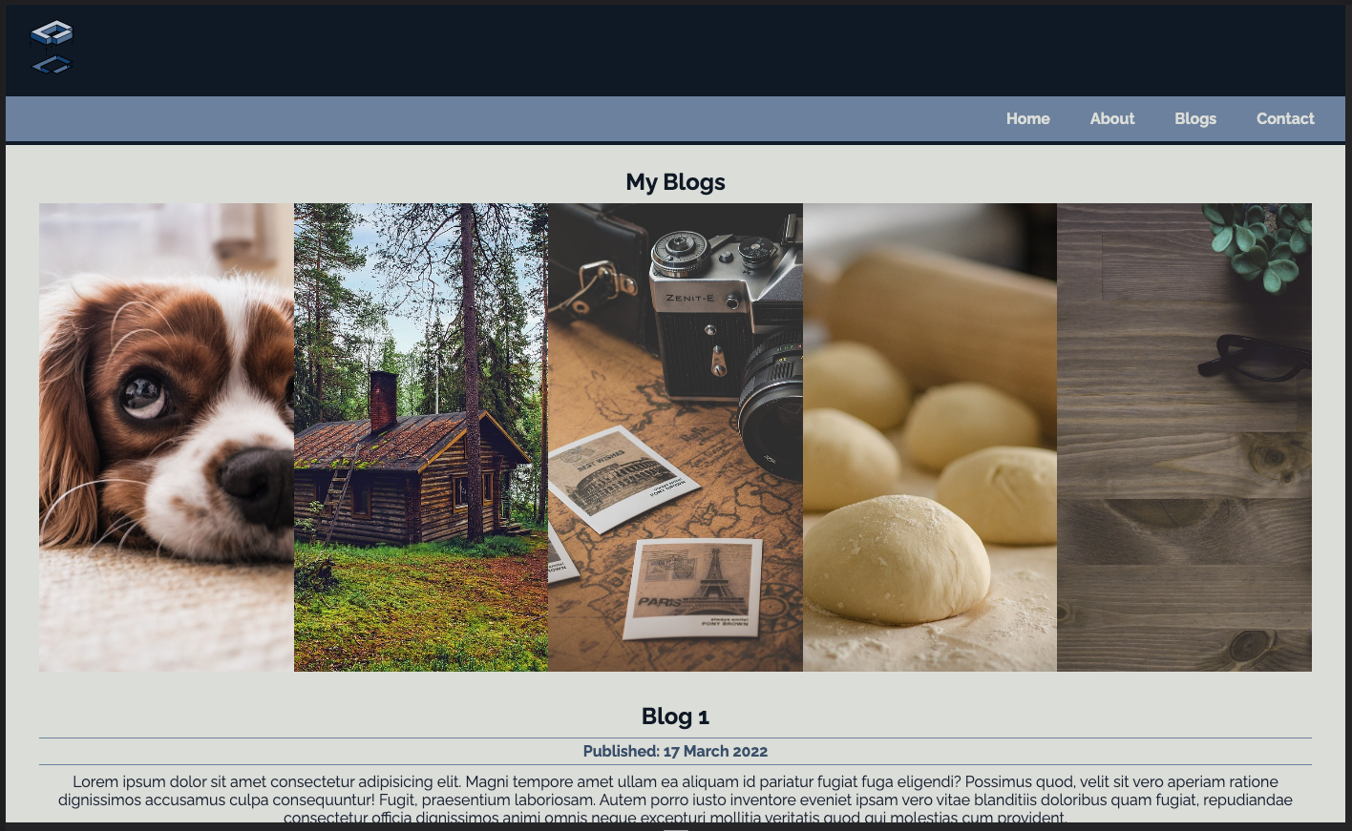

Slide 19
Shapes and images – Contact
Needed a fillable form which was quite straight forward, the hardest part was how to make it usable by netlify, but they had easy to understand resources.
I made the map split larger than the standard 50/50 design I had been using, as it didn’t make sense to stretch the form too wide.

Slide 20
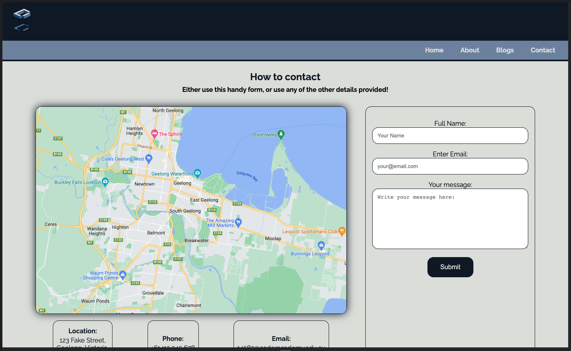

Slide 21

Conclusion
Challenges:
The design itself was the hardest part for me to come up with!
Once I had a design and layout in mind, the process to build this came naturally.
I wanted to extend myself to some of the key elements of dropdown menu’s, key animations and a useable fillable form.
At one time I had about 3x the amount of animations built, but decided this was complete overkill for the site.

Slide 22
Conclusion
Ethical Issues:
The main issue came down to “Is copying/pasting code directly from ChatGPT generation acceptable?”
I answered ”no”, so while I utilised this tool to help refine and assist with the framework, I never used the functions it provided in a copy/paste fashion.
If it gave a response that happened to work, I would do research on why it worked in this way, and whether this is the normal way to implement the styling.
Often however I found the answers it gave were not correct, or not exactly what I asked for, but this would generally produce a key concept I had been missing, allowing me to realise how I could change the responses to work for me.

Slide 23
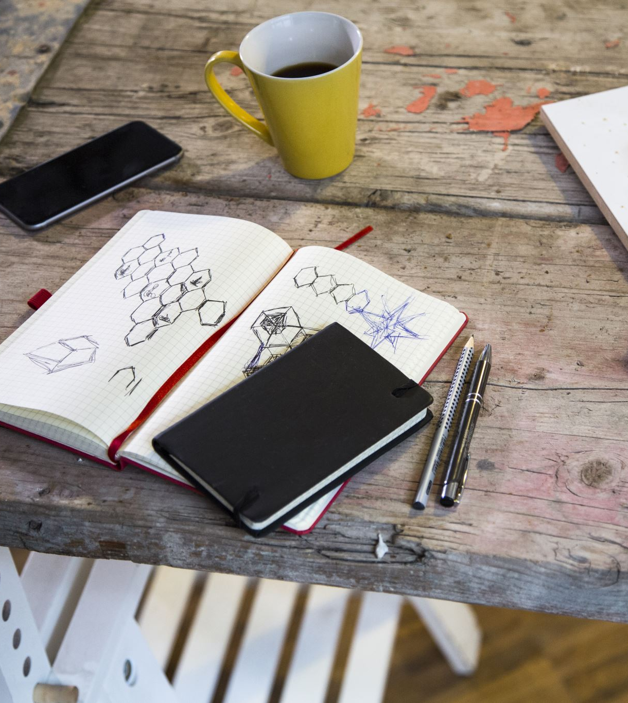
Conclusion
Favourite part:
I have 2, the first is the dropdown for Blogs 1,2,3,4 and 5 when viewing in a tablet or desktop layout.
I knew I wanted this design from the start, it was one of the first bits of styling I did, and I am really happy with how it turned out.
The second is similarly to do with the blogs, but this time the cards that appear at the top of the blog page, that transition to opaque on hover and then link directly to the blog post.

